Slide 1
MCP vs A2A
Tools vs Agents
https://medium.com/data-science-collective/mcp-vs-a2a-building-bridges-between-ai-agents-f6b64be97a35

Slide 2

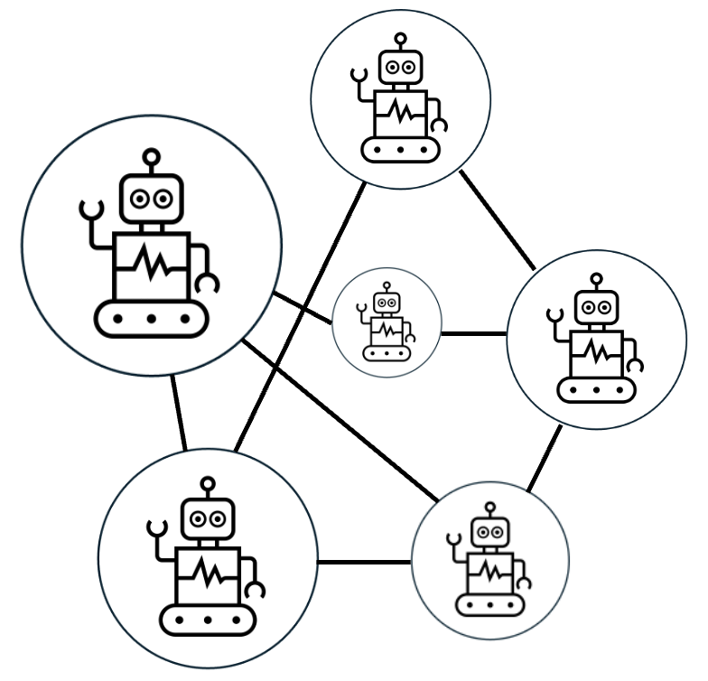

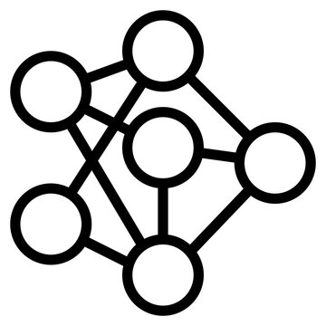

Tools
+
LLM
Agent
Agentic AI
MCP
A2A

Slide 3
Function Calling | MCP | A2A
Built into specific LLM APIs Functions live in the same process/environment Limited to single-agent orchestration Tied to specific vendors | Standardized tool and data access Client-server model for capability extension Resource and function interfaces Model-agnostic design | Open standard for agent interoperability Agents can be on different systems/organizations Natural language task delegation Vendor-neutral with enterprise security

Slide 4
Agentic Mesh
Orchestrated Agents
Agent + tools
Workflows
(graphs)
Prompt

Slide 5
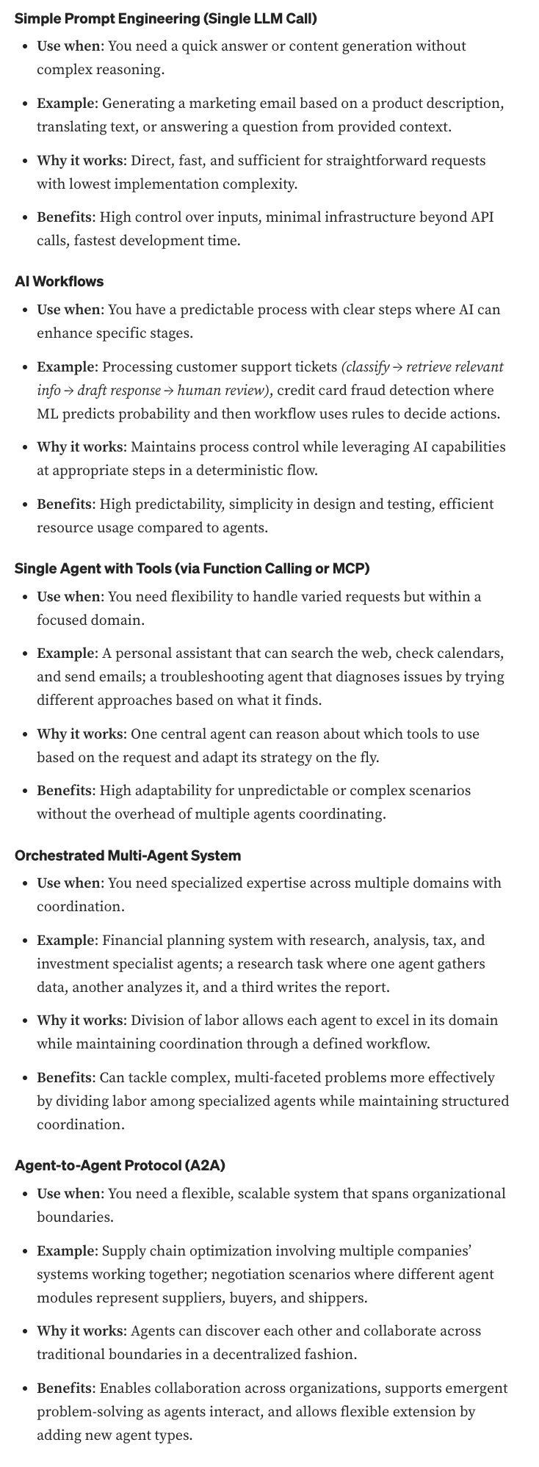
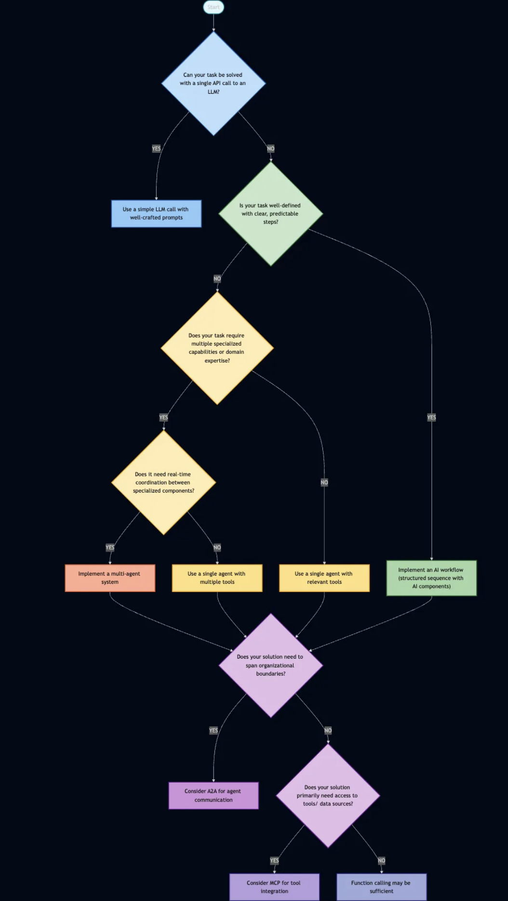
https://medium.com/data-science-collective/mcp-vs-a2a-building-bridges-between-ai-agents-f6b64be97a35

